Slide 1
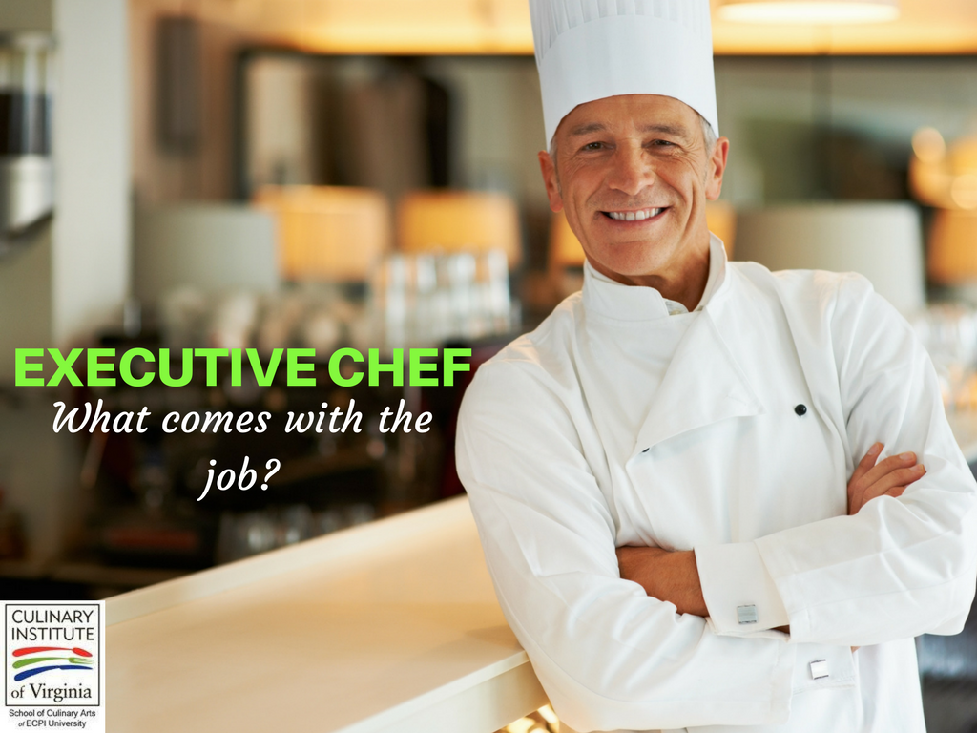
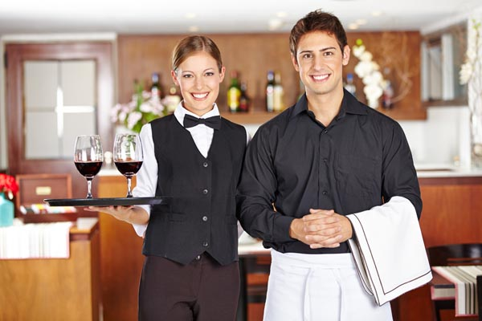
Jobs in a restaurant
Presented by Milina Kosanovic

Slide 2
executive chef- head chef, the leader in the kitchen, responsible for planning menus and supervising staff

Slide 3
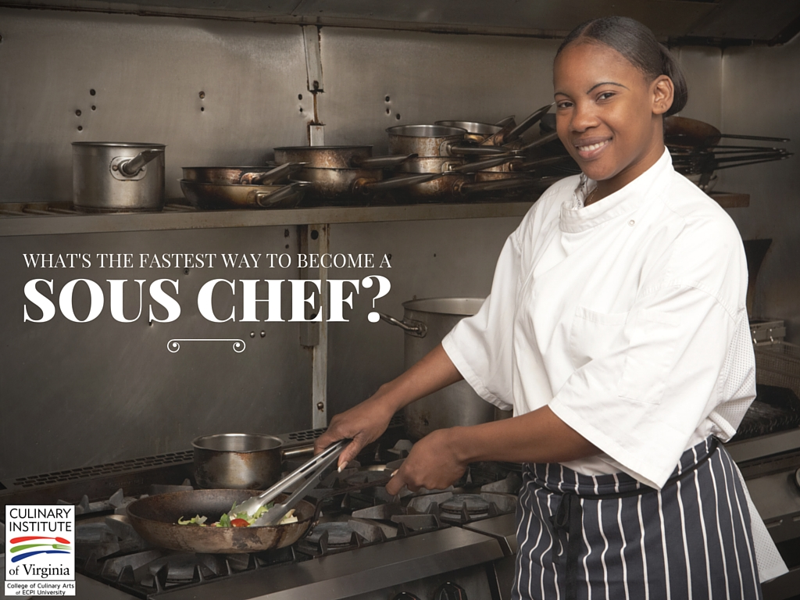
sous chef- second in command in the kitchen, he or she answers to the chef, but also has some authority over the other kitchen staff

Slide 4
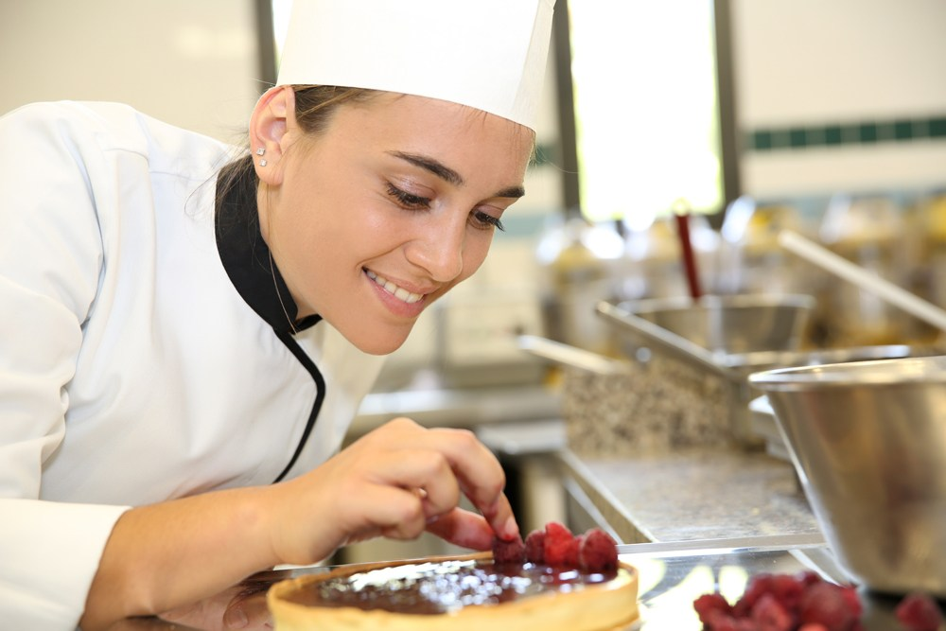
pastry chef- a chef skilled in the making of pastries, desserts, breads and other baked goods

Slide 5
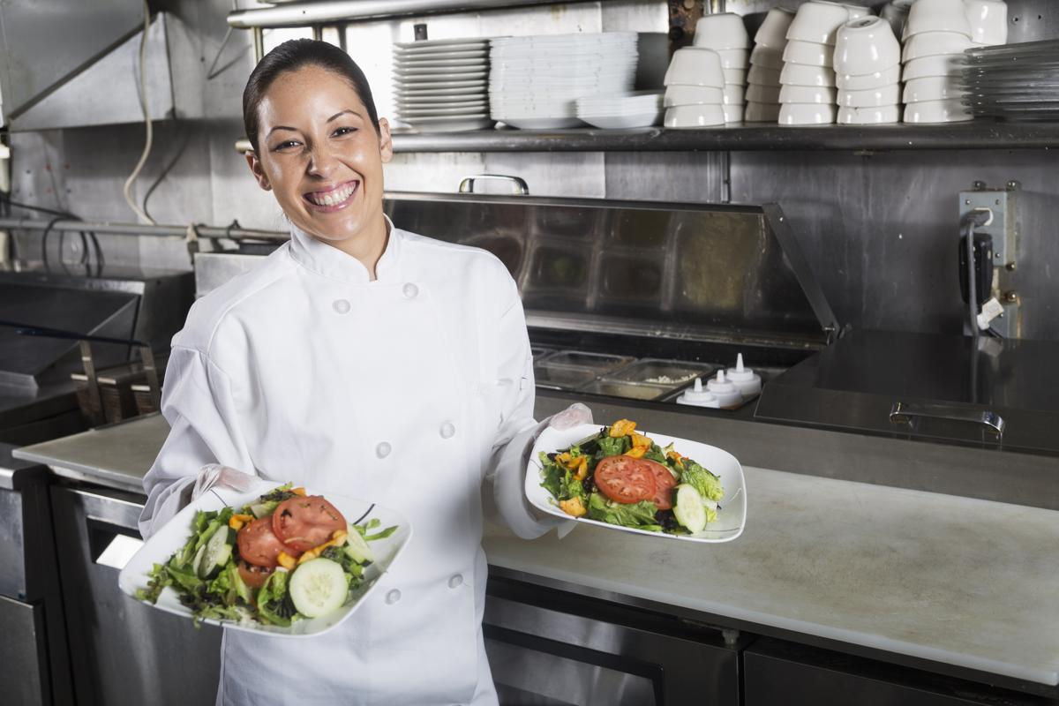
pantry cook- also garde manger- a person in charge of cold food, although they might prepare hot dishes as well. They prepare salads, cheese, sandwiches

Slide 6
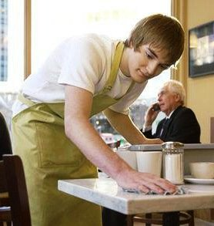
bus person/busser/ busboy, busgirl
Bus person clears off tables, and takes care of supplies such as plates, glasses, utensils, and napkins.

Slide 7
server/waiter/waitress- brings food and drinks to guests
today most restaurants are using the term server for both male and female employees

Slide 8
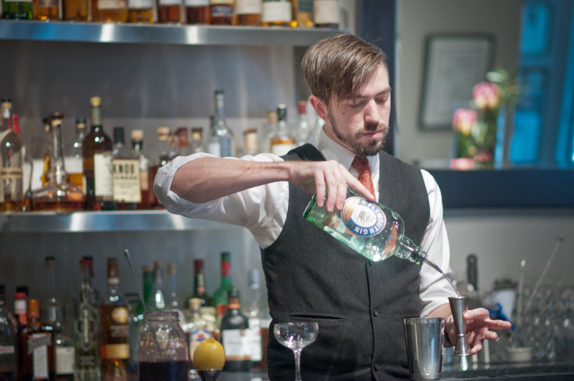
bartender
a person who prepares drinks at the bar

Slide 9
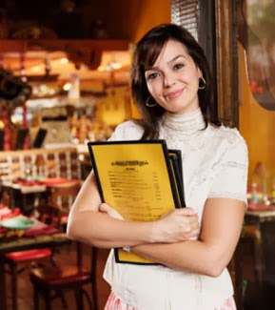
host/hostess- greets guests, takes them to their table

Slide 10
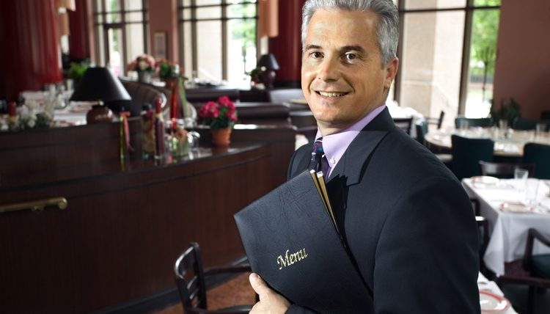
maitre d`hotel- a head of customer service. He greets people as they arrive and visits tables to check if customers are satisfied.

